Slide 1
Track It!
IOT Project
B.Tech Comps 2nd Year
Div: E
E015
E017
E022

Slide 2
Introduction
Our idea is to make a user friendly Android application that helps students keep a track of things like attendance, assignment submissions, etc.
Right now there are two main parts to the application:
The attendance tracker
And a daily objective tracker for the user.

Slide 3

Why use this app?
Many of us have faced the situation when we want to bunk a lecture but are worried about our attendance being very low or when we think we have enough attendance and bunk some more lectures but end up in the defaulters list.
This problem can be solved with this application as it will clearly tell the user how many more lectures he/she needs to attend to be clear of the defaulters.
It will give a prior notification to the user as soon as his attendance goes below the minimum attendance required in the form of an alert.

Slide 4
Why use this app? Contd.
The application will also keep a record of all the assignments and their deadlines for the user thus making it easier for the user.
The user can also set small daily goals like completing 15 questions of an assignment and if he/she fails to complete it on that day then the user will be notified and the remaining pages will be shifted to the next day or any other day of user’s choice.
This app will eliminate any chance of mistake while calculating the attendance by the user.

Slide 5
Characteristics of Proposed Idea:
User Friendly: This application shall be user friendly because all the user needs to do is set a minimum attendance percentage and their time table. Once this is done they will get regular attendance updates.
Reports are easily generated: Using this application reports like number of assignments completed or remaining with their deadlines can be easily generated whenever and wherever the user wants.
Alerts: The application will give regular alerts regarding everything so that the user is well aware of his/her situation.

Slide 6
Implementation
For implementation of this idea the following things are very necessary:
Database: We need to set up a small database to store the timetable and all the assignments. This is the most important part as without this the application is useless. We plan on using SQLite to setup a local database.
Timetable and Attendance Entry: We need to come up with an efficient and easy way to store these things.
The UI: The user interface should be smooth ,fast and easy to use so that anyone can use it and it doesn’t take much of their time.
Notes:
Implementation is the stage of the project when the theoretical design is turned out into a working system. Thus it can be considered to be the most critical stage of its development.

Slide 7
Plans for implementation
The way we wish to achieve our objective is by using databases to store all user related information.
For a single user the system SQLite databases can be used but for the group feature the data will have to be stored on a web server . This can be achieved using Xampp
Xampp is a software package which allows us to run a web server on a local machine. It provides a database management system called phpMyAdmin which can be used for creation and regular updation of the various tables required for this project.

Slide 8
System Requirements
The minimum version required to run this app will be android Jelly Bean.
By targeting Jelly Bean the app will be able to cover over 90% of the existing android devices
It will also allow us to access and use latest features for the development of our app since it is a relatively modern API
An earlier API is not targeted as the earlier versions of android lack some of the functionality which later versions have.

Slide 9
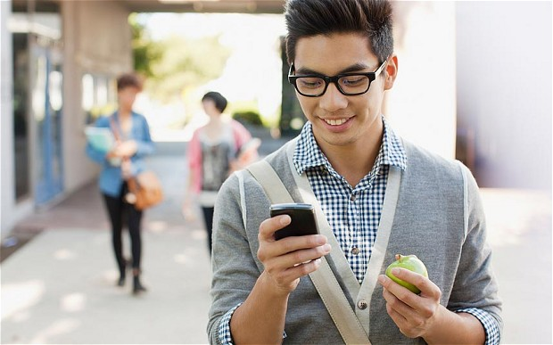
Target Audience
The main target audience for our app are students who want to keep a regular check on their attendance and tasks assigned to them.
It also targets people who like to stay organized and be regularly notified about their progress in certain tasks.

Slide 10
PROGRESS

Slide 13
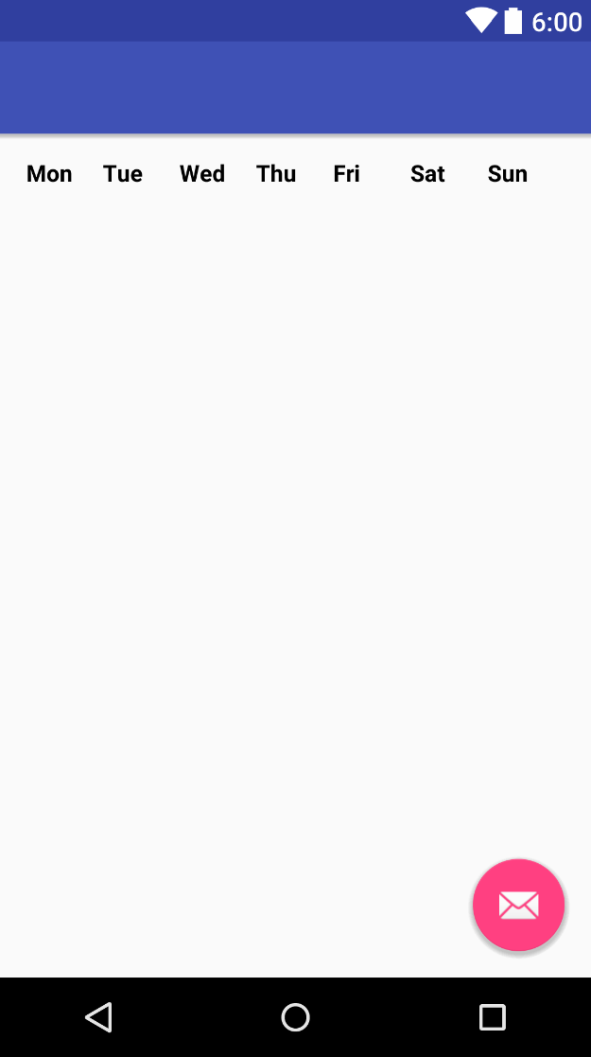
This is the page where the user can look his timetable up it will have all the subjects with their timings and we plan on showing the user whether he has attended a particular lecture or not on this page itself.

Slide 14
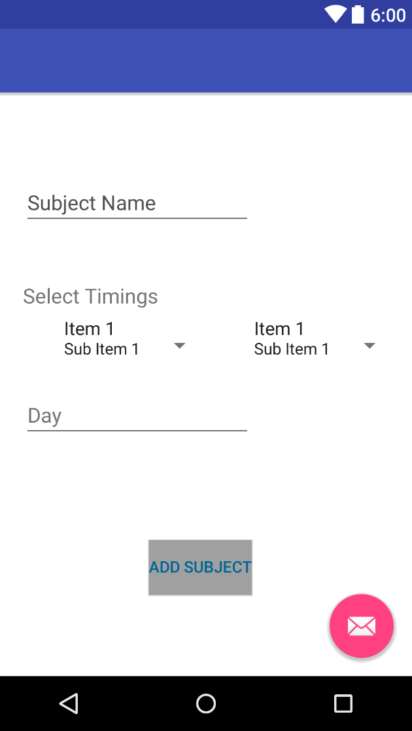
This the page where the user enters his timetable in the database. He has to input the subject name and their timings and the day it’s on. Once this is done there is no need to enter the timetable ever again

Slide 15
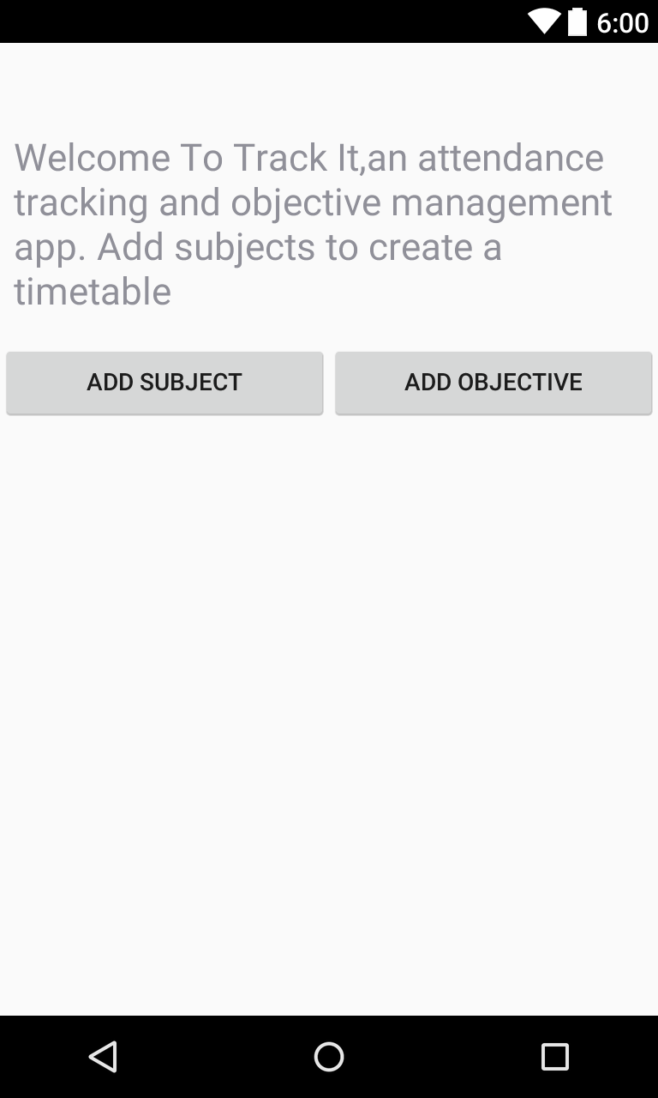
This is the home Page of the app. Here the user can choose whether he wants to add a new Subject to create his timetable or create a new task

Slide 16
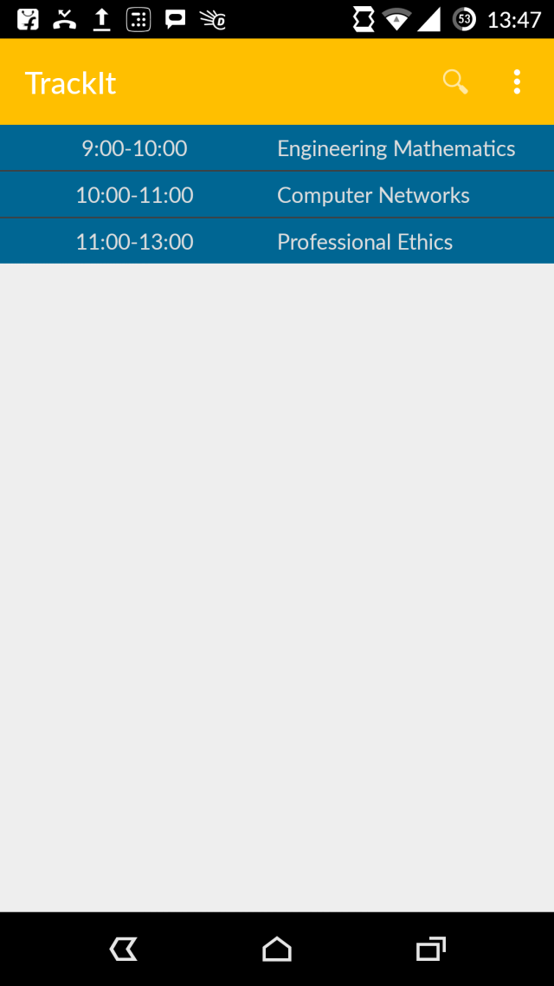
This the page where the user enters his timetable in the database. He has to input the subject name and their timings and the day it’s on. Once this is done there is no need to enter the timetable ever again

Slide 17
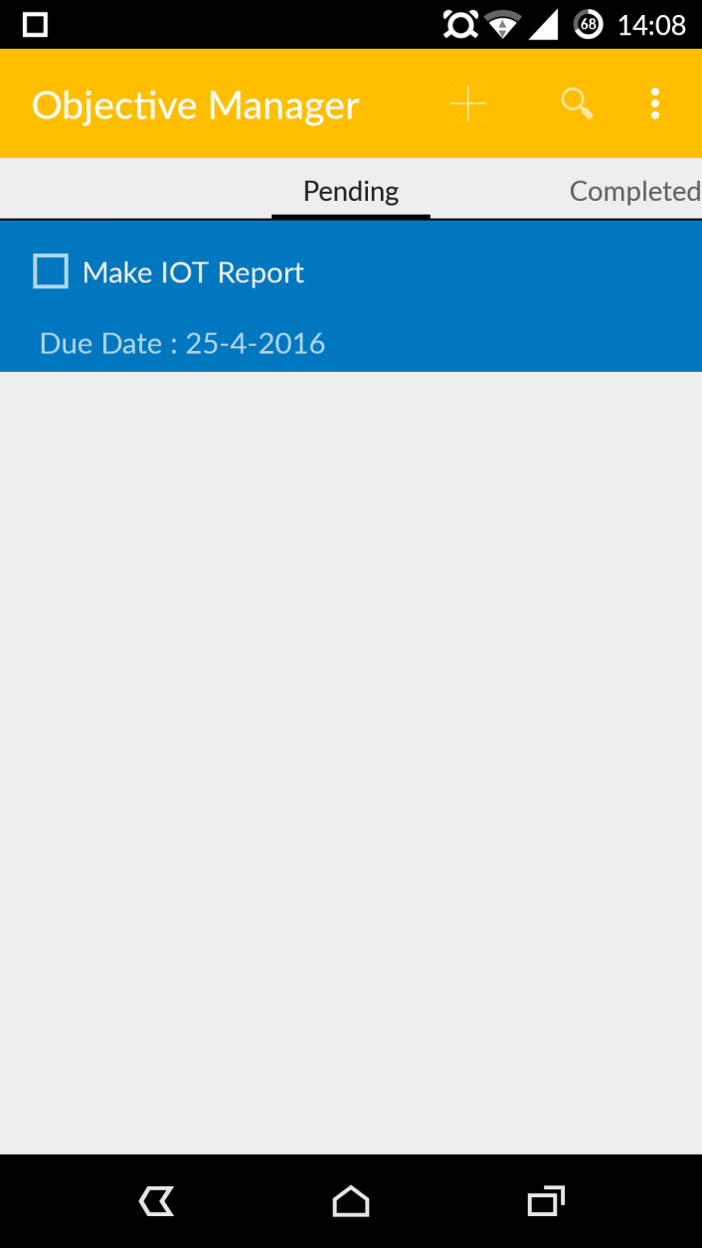
This is the pending objectives page. Here the user can view his pending objectives and upon swiping the user can view his Completed objectives. The user can check the checkbox if a particular task has been completed.

Slide 18
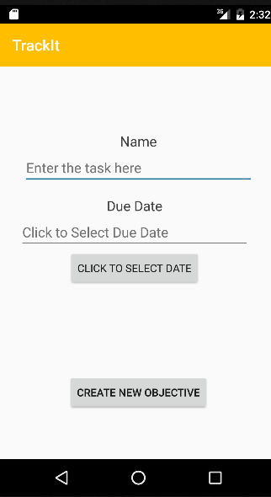
This is the AddObjectiveActivity. Here the user can create a new task. The user needs to enter the name of the task and also set the deadline. Once that is done the user just has to click the create objective button and the database is updated.

Slide 19
Thank You

